Slide 1
Design and Simulation of an Automatic Street Light Control System
Using Combinational Logic
Sriram Reddy Mokshith Reddy Bhuvan Aaryan M. Pardhu

Slide 2
Introduction
• Street lights provide visibility and safety during night-time.
• Manual switching can lead to unnecessary power consumption.
• An automatic controller can switch the light based on sensor conditions.
• This project demonstrates a simple controller using combinational logic.
2

Slide 3
Objective
• Design an automatic street light control circuit.
• Use binary inputs from a light sensor and a motion/vehicle sensor.
• Implement the control logic using an AND gate.
• Simulate and verify the design using Logisim.
3

Slide 4
Inputs and Logic
A — Dark Sensor
A = 1 → Dark A = 0 → Bright
B — Motion Sensor
B = 1 → Motion detected B = 0 → No motion
Street Light = A AND B
4

Slide 5

Truth Table
The output is HIGH only for the required input combination.
5

Slide 6
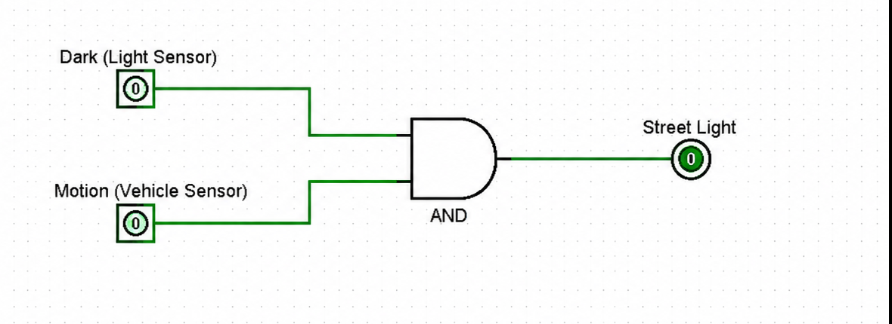
Logisim Circuit
Two sensor inputs are connected to a 2-input AND gate, which drives the Street Light output.
6

Slide 7
Working
• When it is bright, the Dark input is 0, so the street light stays OFF.
• When it is dark but no motion is detected, the output stays OFF.
• When it is dark and motion is detected, both inputs become 1.
• The AND gate then produces 1 and the street light turns ON.
7

Slide 8
Advantages
• Automatic operation without manual switching.
• Reduces unnecessary electricity usage.
• Simple and easy-to-understand combinational circuit.
• Fast response to sensor inputs.
• Can be expanded with additional sensors and logic.
8

Slide 9
Conclusion
• The automatic street light controller was designed using combinational logic.
• The AND-gate implementation provides a simple control mechanism.
• The Logisim simulation verifies the circuit operation.
• The design demonstrates how digital logic can be used for basic automation.
9

